Slide 1
Jeep Renegade Presentation
Submission Date: 4/24/2022
By: Abe Diaz

Slide 2
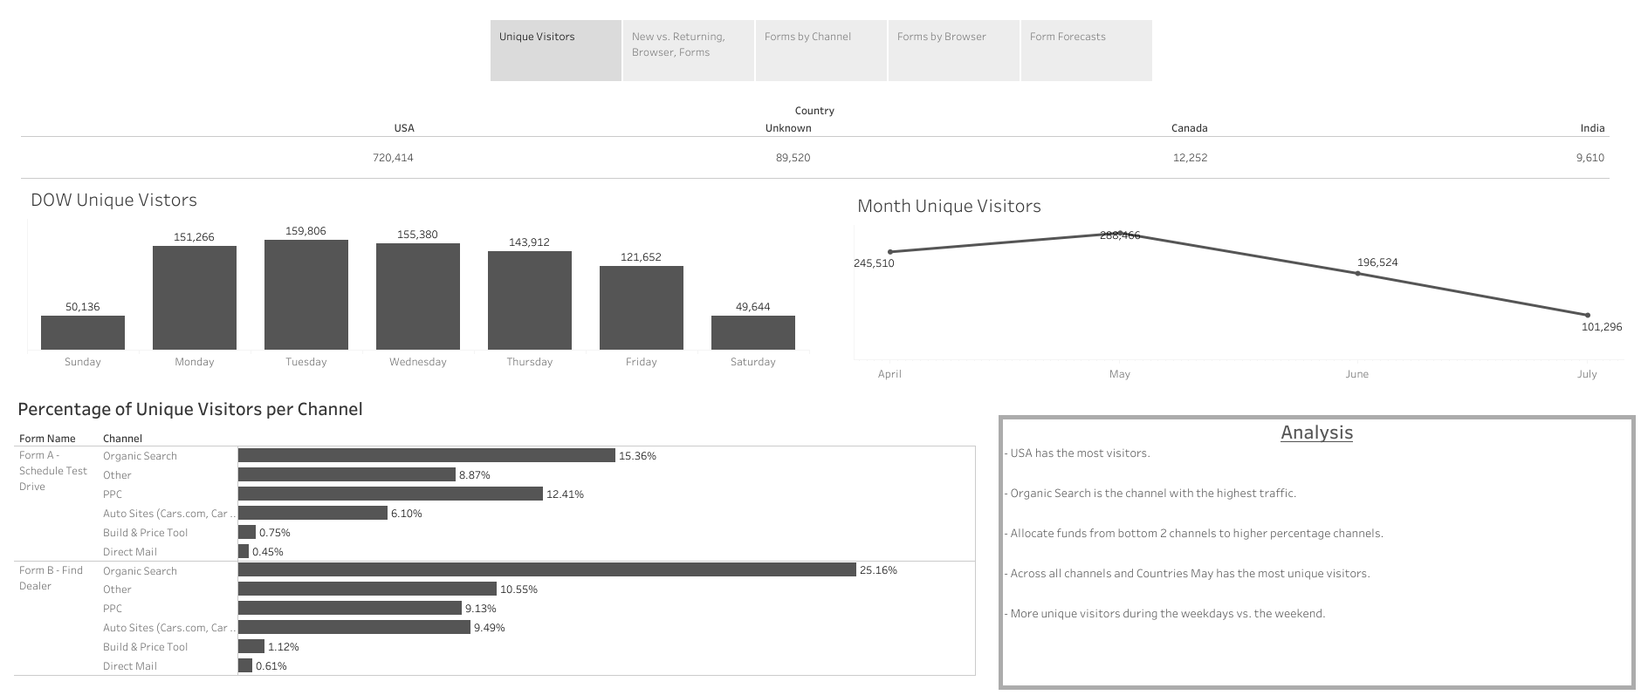

Slide 3
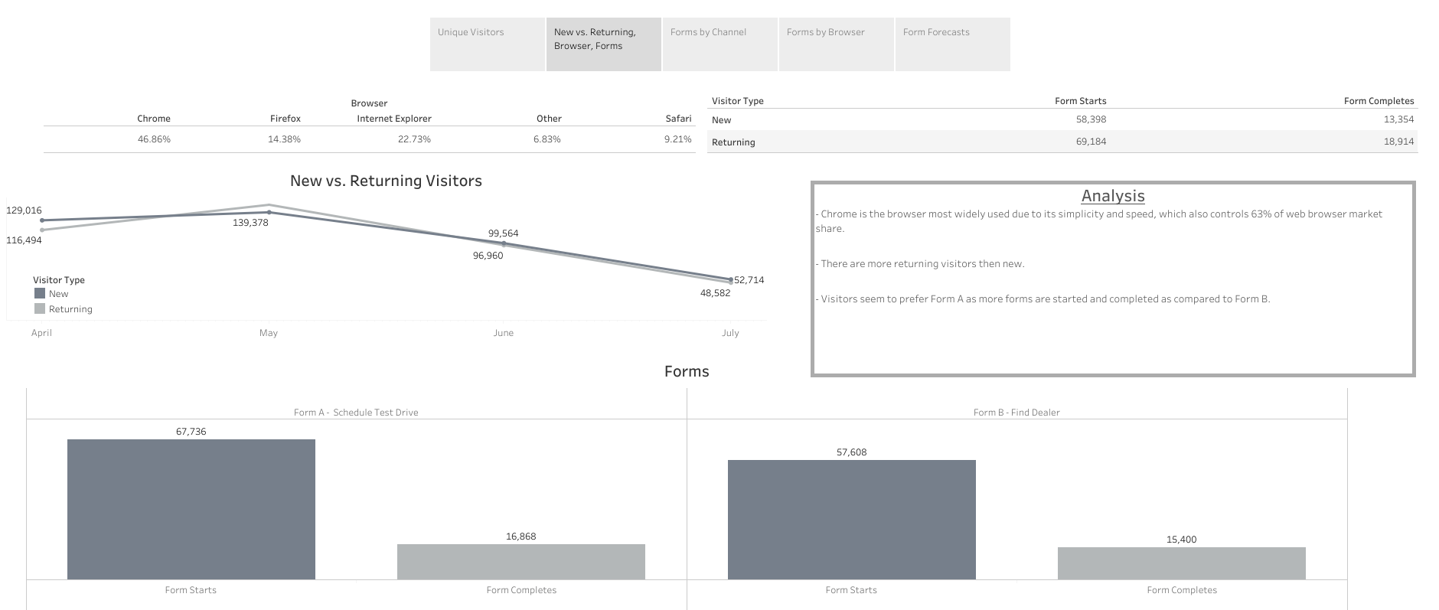
Notes:
- Chrome reference https://www.oberlo.com/statistics/browser-market-share

Slide 4
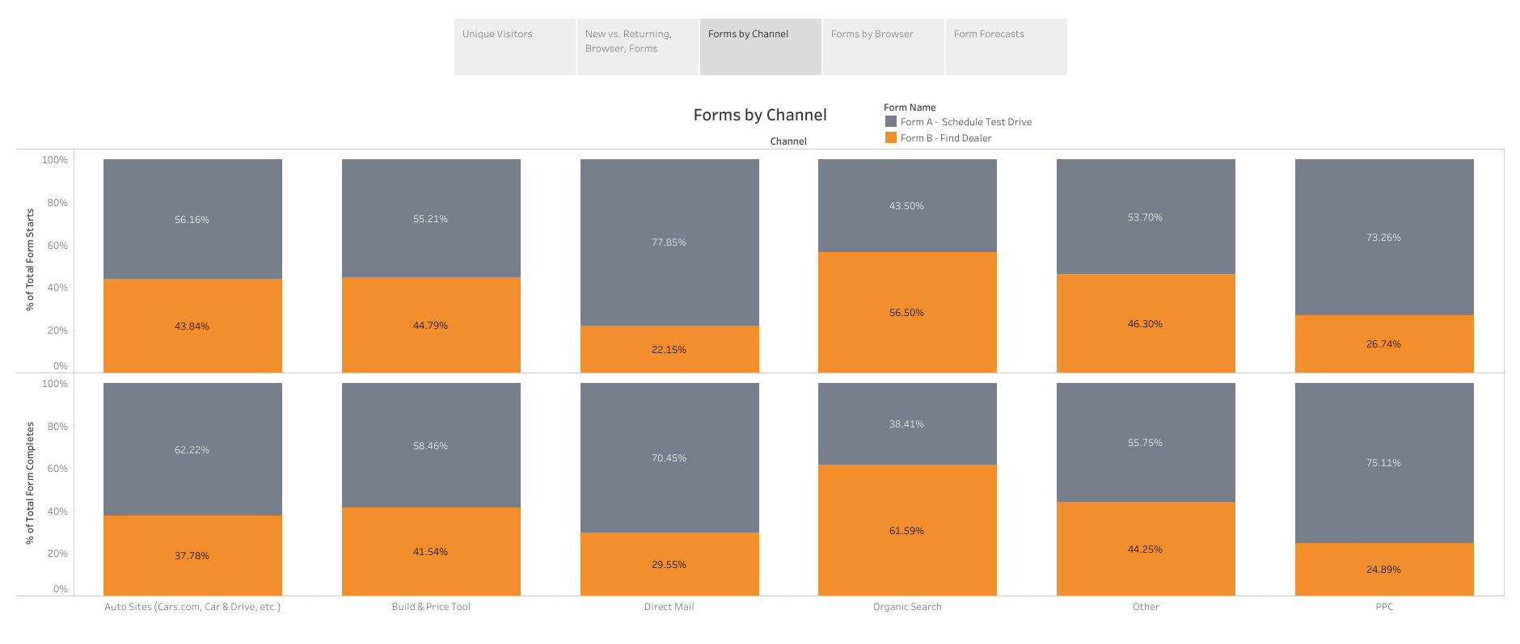
Notes:
Form A, Direct mail & PPC has the highest percentage of starts and completes .
Form B, Organic Search is higher then Form A although OS has the most visitors overall.

Slide 5
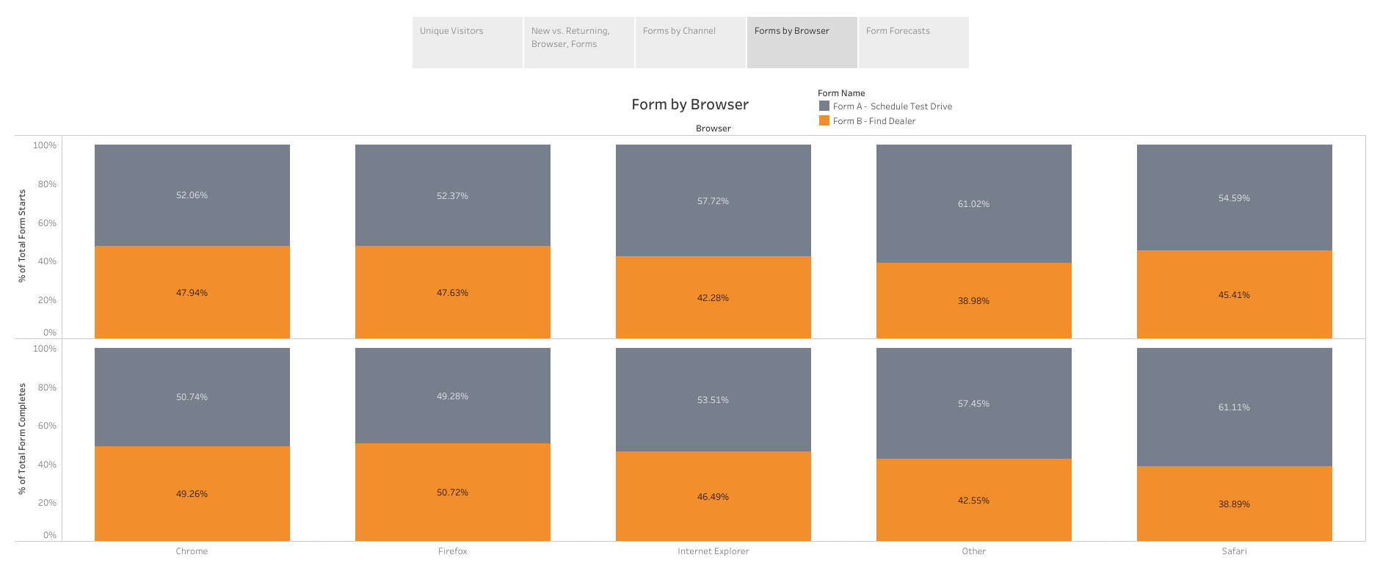
Notes:
Adhoc Tableau example - https://www.youtube.com/watch?v=veB0MdDZqWQ
Form A, Other has the most starts and completes.
Both forms starts & completes are almost evenly split per browser.

Slide 6
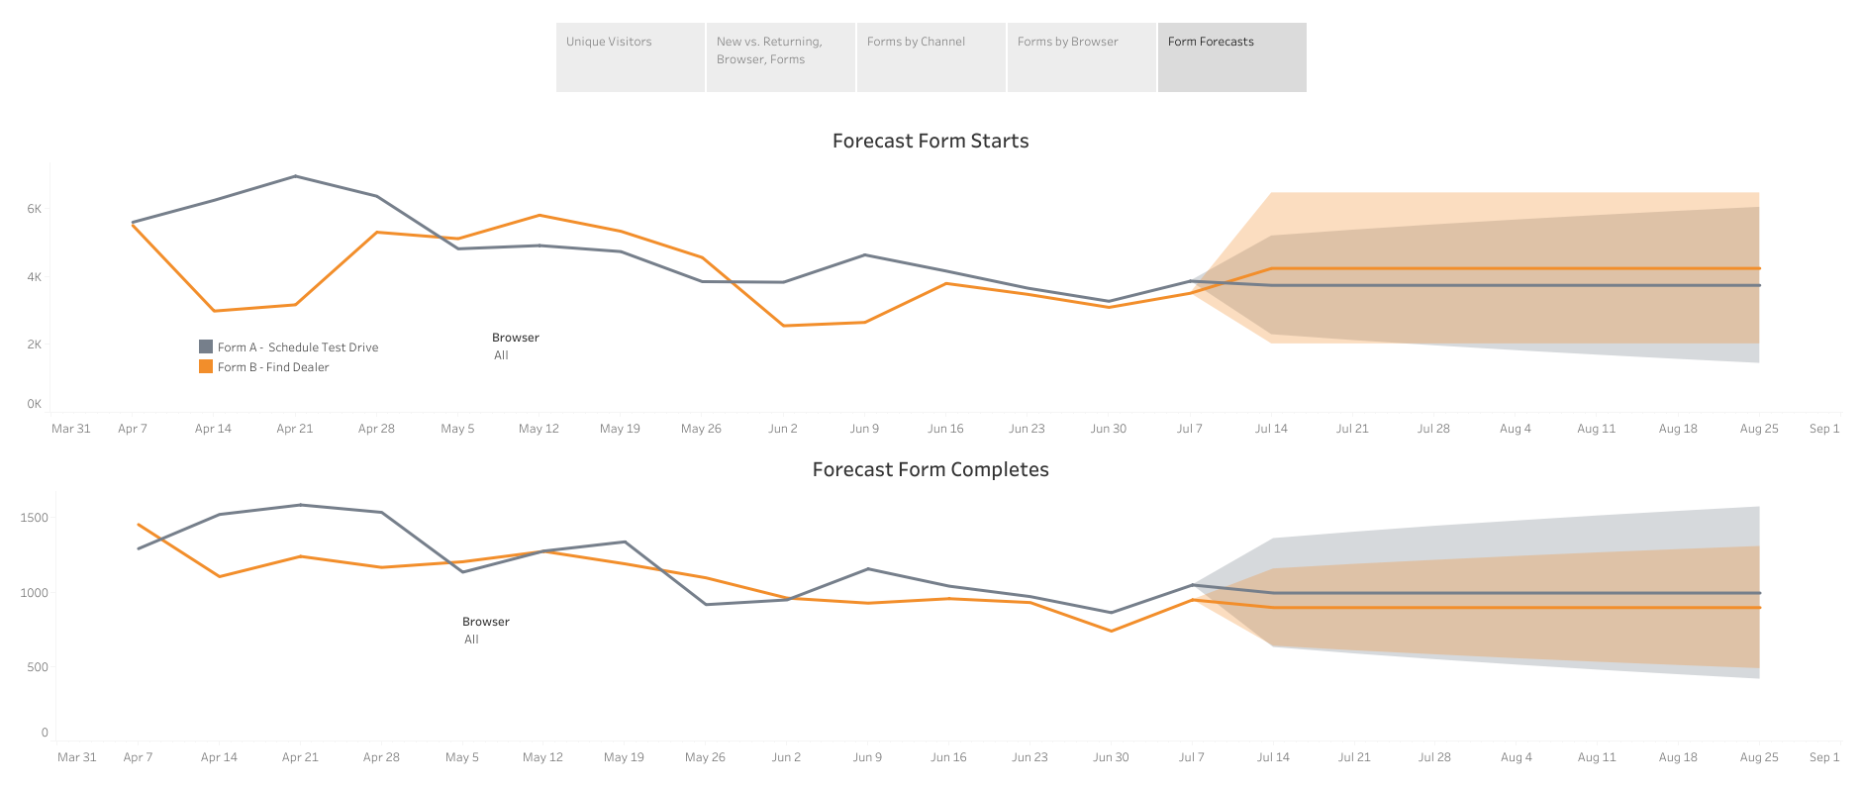
Notes:
Form B is forecasted to have more starts.
Form A is projected to have more completes.
Visitors are almost even when starting forms using the Chrome browser, but Form B is completed more often.

Slide 7
Summary
Requested data points
Analysis/Recommendations
Visitors are more likely to start and complete Form A
Organic Search via Chrome is how and where visitors shop for a Renegade
Conduct A/B testing along with sales figures to further determine that Form A has more completes
Sales figures would help determine profitability between forms, channels, and browsers
Marketing data to determine ad spend
Visitor demographics

